Slide 1

Collaborative engineering with IFC new insights and technology
Léon van Berlo - leon.vanberlo@tno.nl

Slide 2
This will be a positive message

Slide 3
two presentations: one for researchers – one for practitioners

Slide 4
For Researchers…
Motivation and Goal of the research
Levels of BIM / location of a central modelserver
Research questions
Experiments
Observations
Results
Conclusions
Discussion and Future work

Slide 5
The Research:
Dutch BIM modelserver experiments:
Who is responsible for transformations of the data?
How significant are workflow changes?
How important are the import/export functions of modellingsoftware? → preventing loss of data!
What data needs to be shared, when?
How should locking and releasing of objects work?
Answers.… please read the paper!

Slide 6
The story I tell the Dutch industry….

Slide 7
1998: Birth of “the central model”

Slide 8
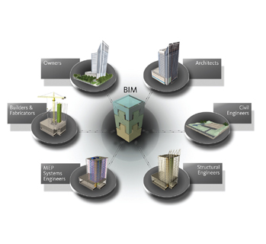
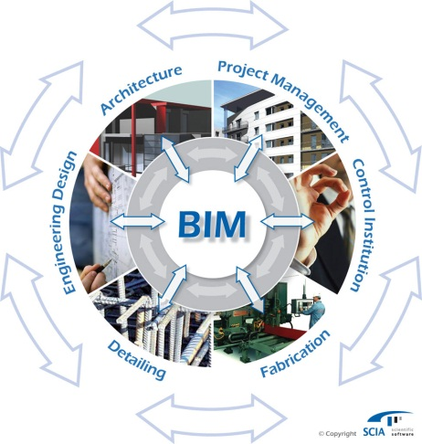
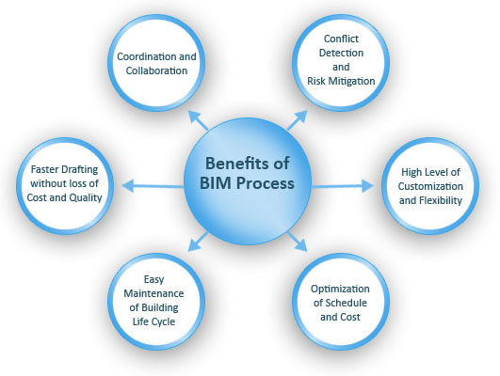
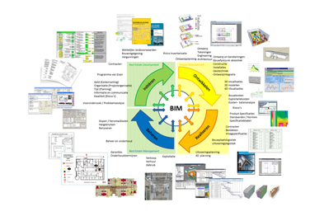
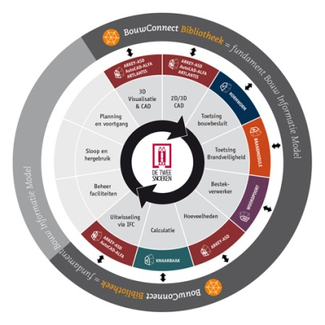
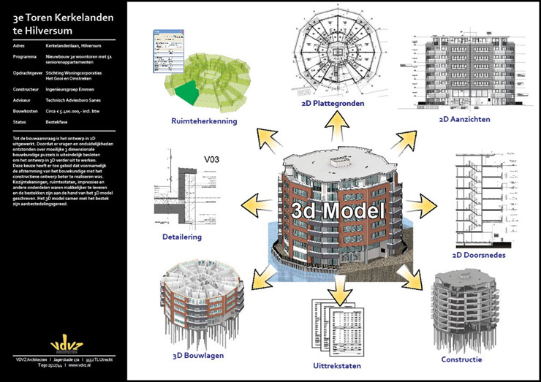
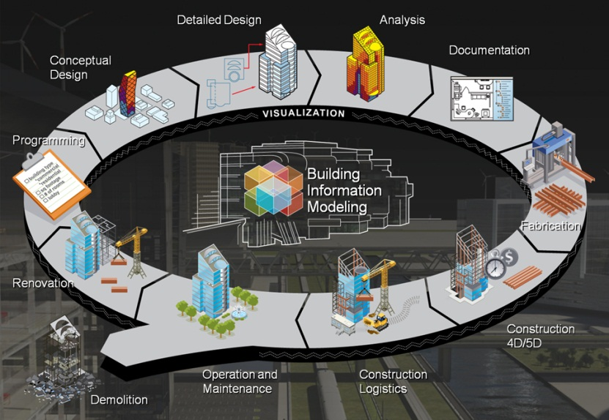
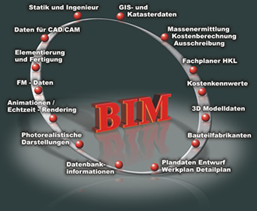

Slide 9


Slide 10
Misconception (misinterpretation):
Shared data model is NOT equal to:
Shared BIM model instance
Shared data
“Shared data model” comes from the need to share/distribute data in a standardized way….
“shared data model” == creating agreements (standards)

Slide 11
huh…? So why do you want a “central” modelserver?

Slide 12

Why a ‘central modelserver’?
Sharing large files (data)… → What information do you share?
Merging / synchronization
Revision management
Alerts
Knowing who to blame
Etc…
Lots of good reasons, but you know why!
Could be just a useful gadget…
…. like shoes with build in music players.

Slide 13
General two types of ‘central BIM Servers’?
Closed data model:
ArchiCAD teamwork (BIM Server)
Revit Server / WAFS (file synchro)
Onuma
Adomi
…..
Open (shared) data model:
EDM model server
EuroStep (doubt)
Open source BIMserver.org
+ spinoffs
…..

Slide 14
General two types of ‘central BIM Servers’?
Closed data model:
Working with the same software (live) in one data instance
Open (shared) data model:
Working with different software (using IFC)
Sidestep for researchers:
Our research question was: “Which approach is best for the AEC industry?”. Or: “Is IFC suitable for use with modelservers?”

Slide 15
Which one should I choose? Which one is best as a ‘central’ server?
Huh? →

Slide 16
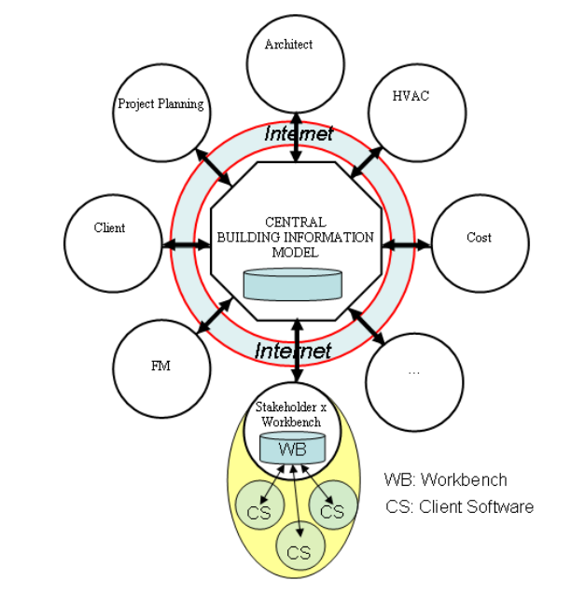
Bron: Nour

Slide 17
BIG BIM →
little BIM →

Slide 18
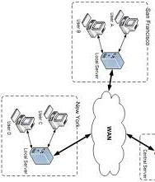






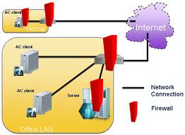

Slide 19
“There is no CENTRAL model” (there are shoes with integrated music players)

Slide 20
Ok…. Everybody has their own ‘central’ model

Slide 21
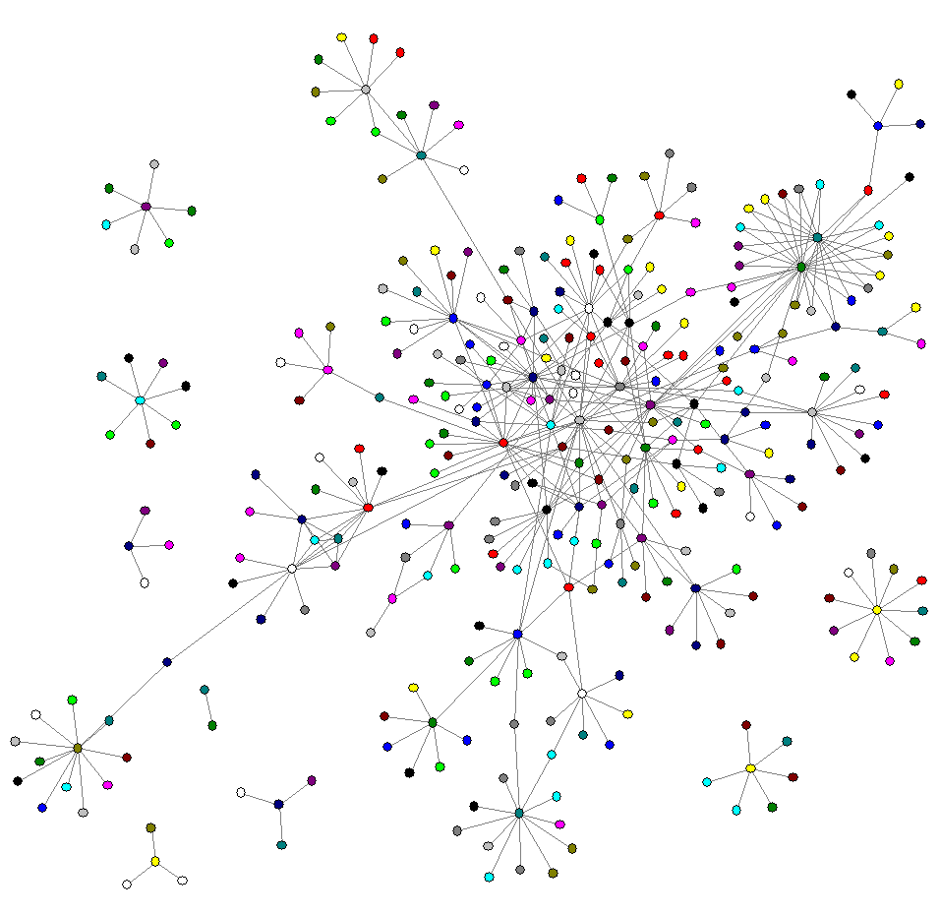
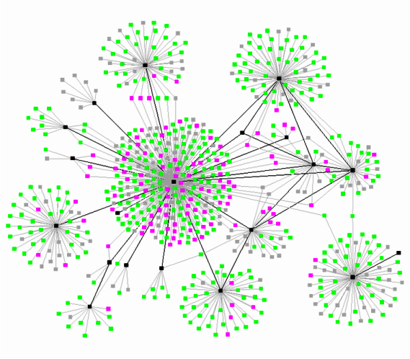

Slide 22
Proof?

Slide 23
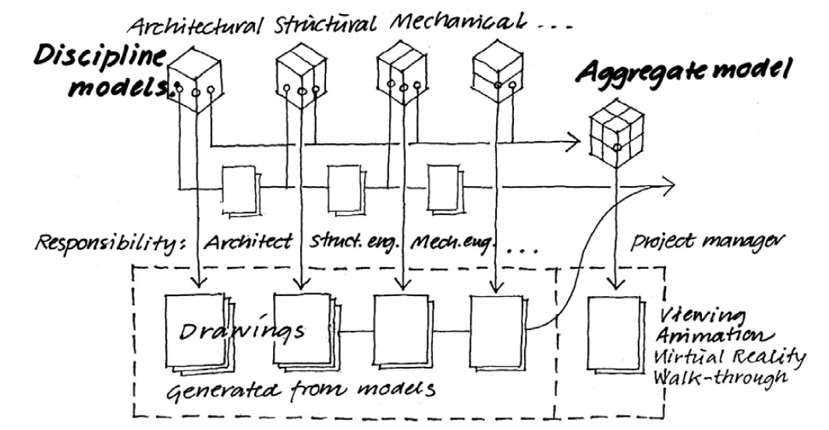
US:

Slide 24

UK:

Slide 25
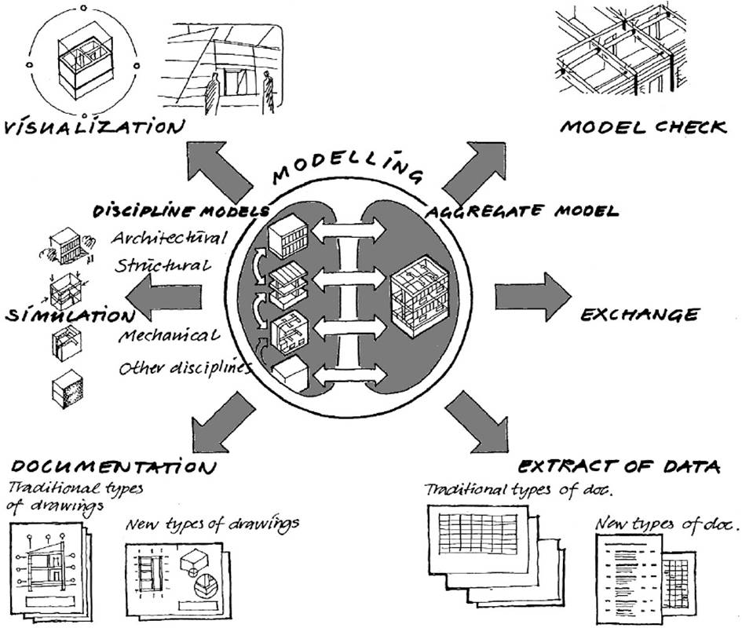
Denmark (June 2008):

Slide 26
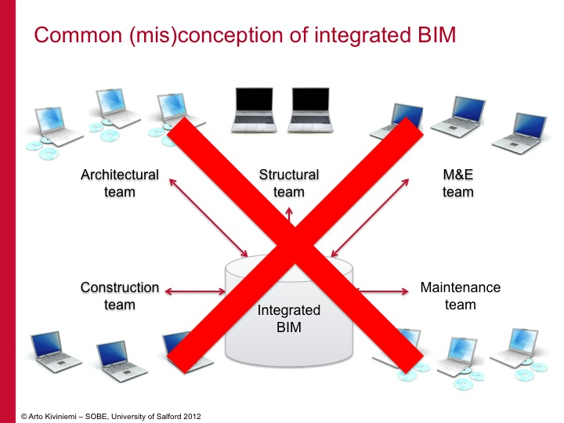

Slide 27
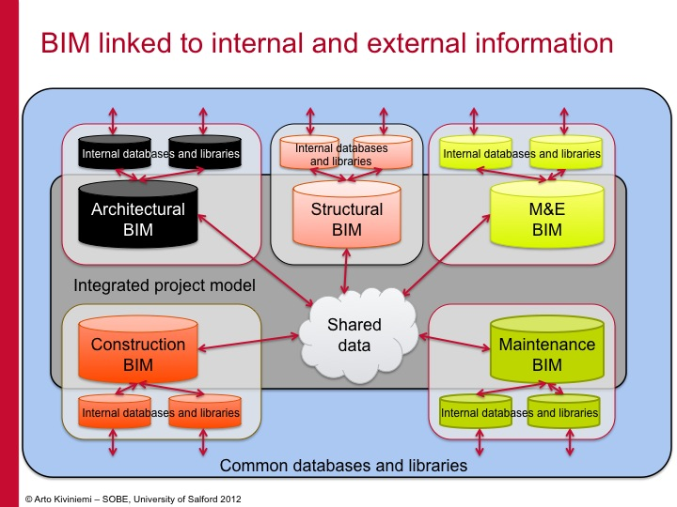

Slide 28
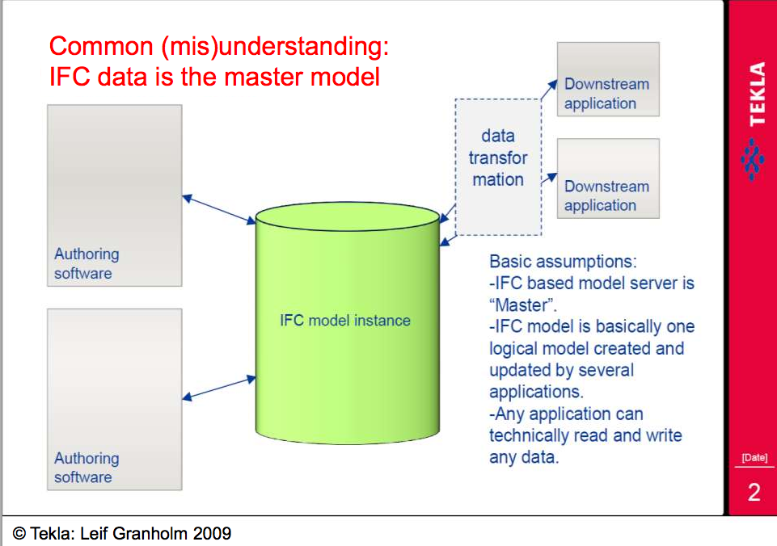

Slide 29
But ‘we’ (in the Netherlands) also know this...

Slide 30
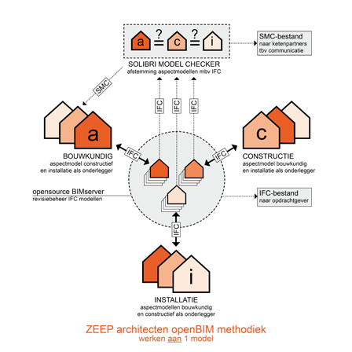

One experiment:
© ZEEP architects, the Netherlands

Slide 31
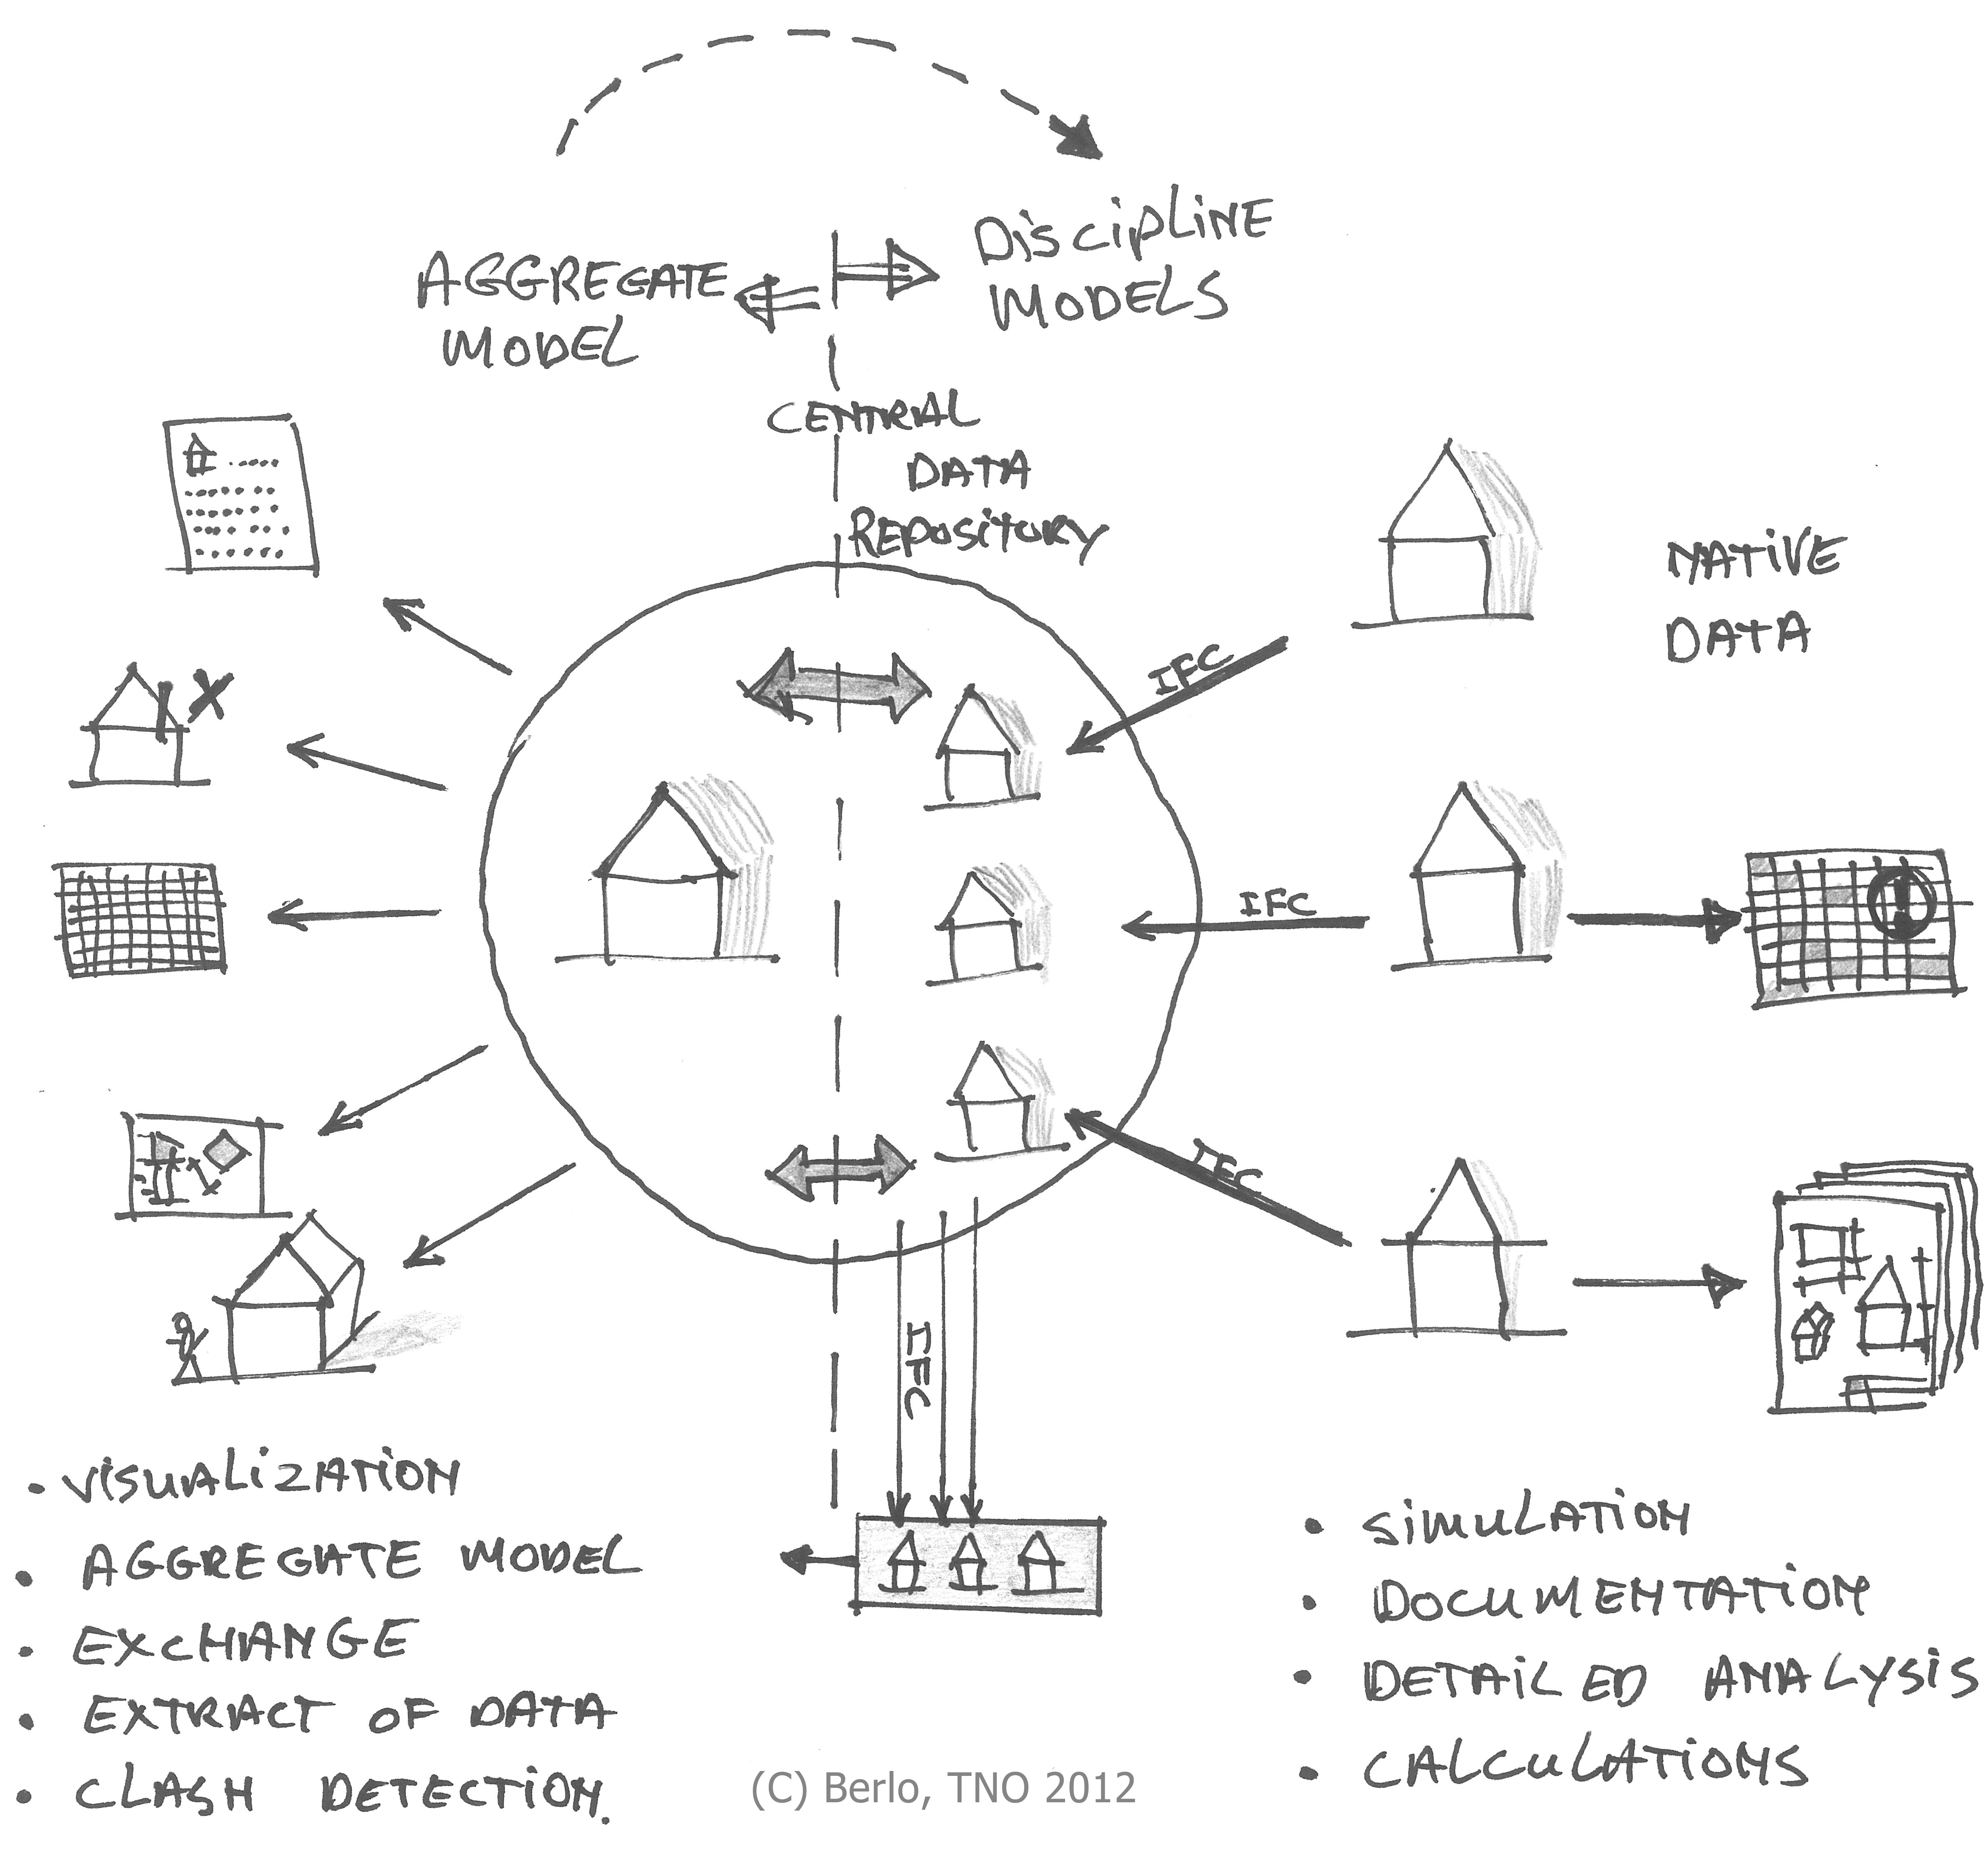
Our research:

Slide 32
Our research:
NO ROUNDTRIP
(import/export in a chain of tools)

Slide 33
Observations:
“There is no loss of data using IFC”… It is all in the native software. The question is what data you want to share (using IFC). What data do you need to do your job? Then we look if that is in IFC (and in your tool after import)
Not a single IFC ‘loss of data’-issue occurred during the experiments!
The best choice modelserver, depends on the place in the BIM framework (‘little bim’, ‘BIG BIM’). In many situations it seems favorable to use a combination of homogeneous software environment (‘little BIM’) and plural software environment (‘BIG BIM’) in a multidisciplinary collaboration project.

Slide 34
Observations:
The synchronization interval depends on several factors such as: the preferences of the project team members, the project manager and the project phase. Users in the experiments in this research did not prefer a so-called ‘live synchronization’. The median of synchronization time of model instances was 1 week (every Friday of every week was a widely used practice).
In a homogeneous software environment, users felt that all team members should have equal BIM software modeling expertise. When using the concept of reference models, not all project team members collaborating in a project need to have the same level of BIM expertise.

Slide 35
And to close up….
The use of a reference model concept with IFC can lower the needed BIM competences for a project partner to be able to collaborate in a way that is sufficiently effective for the entire project team.
All respondents in this experiment were strongly convinced that choosing project partners based on their competence of a specific software tool, prior to their engineering competence, is never preferred

Slide 36
Found conclusion: Working (live) in a ‘central’ modelserver (everybody the same tool) has more downsides than advantages. (ownership of objects, legal aspects, change requests, etc...)

Slide 37
Other conclusions: The IFC data standard (combined with smart process workflows) creates a stable and usable collaboration environment. IFC meets the needs of the industry (even better than a closed data model server) when used in a process of reference models (as described in the paper).

Slide 38
To conclude: Some interview responses that might be of interest for us researchers….

Slide 39
Conceptions in the market: “Are you using IFC? You are loosing data” “IFC is not finished yet” “There are no xxx in IFC” etc…

Slide 40
“Stop telling everyone that IFC is not perfect yet!”

Slide 41

Thank you!
Paper on page 811 of the ECPPM 2012 book.
Feel free to contact me at leon.vanberlo@tno.nl
@berlotti

